Slide 1

Fatemeh Eslaminasab
Summer 2023

Slide 2

Outline
Executive Summary
Introduction
Methodology
Results
Conclusion

Slide 3
Executive Summary
Summary of methodologies
SpaceX data collection using SpaceX API & Web Scraping
SpaceX data wrangling
SapceX expletory data analysis
SpaceX EDA data visualization using matplotlib & seaborn
SpaceX launch site analysis with plotly Dash
SpaceX Machine Learning predictions (Logistic- Svm- Decision tree- KNN)
Summary of all results
EDA results
Interactive Visual Analytics and Dashboards
Predictive Analysis(Classification)

Slide 4
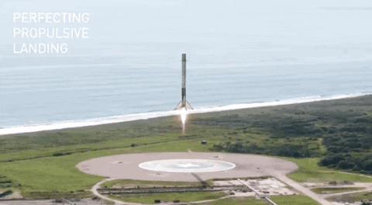
Introduction
Project background
SpaceX advertises Falcon 9 rocket launches on its website with a cost of 62 million dollars; other providers cost upward of 165 million dollars each, much of the savings is because SpaceX can reuse the first stage. Therefore if we can determine if the first stage will land, we can determine the cost of a launch. This information can be used if an alternate company wants to bid against SpaceX for a rocket launch.
Problems you want to find answers
In this project, the goal is to predict if the Falcon 9 first stage will land successfully using data from Falcon 9 rocket launches advertised on its website.

Slide 5

Section 1

Slide 6
Methodology
Executive Summary
Data collection methodology:
Describe how data was collected
Perform data wrangling
Describe how data was processed
Perform exploratory data analysis (EDA) using visualization and SQL
Perform interactive visual analytics using Folium and Plotly Dash
Perform predictive analysis using classification models
How to build, tune, evaluate classification models

Slide 7
Data Collection
Via API
I made a get request to the SpaceX API. A series of helper functions was defined that will help us use the API to extract information using identification numbers in the launch data.
Finally to make the requested JSON results more consistent, the SpaceX launch data was requested and parsed using the GET request and then decoded the response content as a Json result which was then converted into a Pandas data frame.
Via web scrapping
Performed web scraping to collect Falcon 9 historical launch records from a Wikipedia. Using BeautifulSoup and request Libraries, I extract the Falcon 9 launch HTML table records, Parsed the table and converted it into a Pandas dataframe.

Slide 8
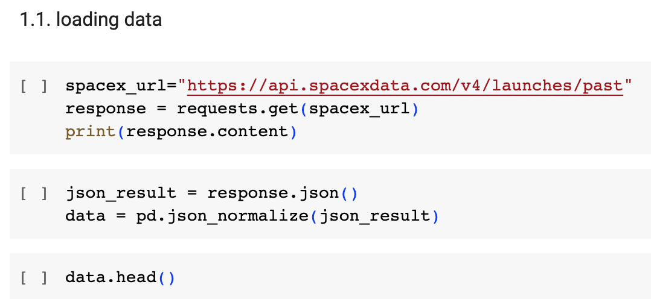
Data Collection – SpaceX API
Data collected using SpaceX API then parsed the SpaceX launch data as a Json which was then converted into a Pandas dataframe
Here is the project GitHub link: the first section is related to data collection SpaceX-Falcon-9-link

Slide 9
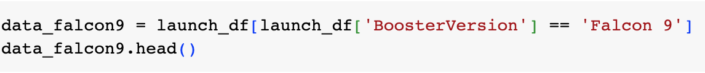
Data Wrangling
Filter the dataframe to only include Falcon 9 launches
Dealing with missing values: replacing them with mean of column:
For the PayloadMass, missing data values were replaced using mean value of column.
Here is the project GitHub link: the second section is related to data wrangling SpaceX-Falcon-9-link

Slide 10
EDA with Data Visualization
Also performed some Exploratory Data Analysis (EDA) to find some patterns in the data and determine what would be the label for training supervised models.
- Exploratory Data Analysis using data visualization (Matplotlib, seaborn, etc)
- Preparing Data Feature Engineering
Here is the project GitHub link: the third and fourth sections is related to Exploratory analysis and Feature engineering SpaceX-Falcon-9-link
A few samples of data visualization are shown in following slides

Slide 11
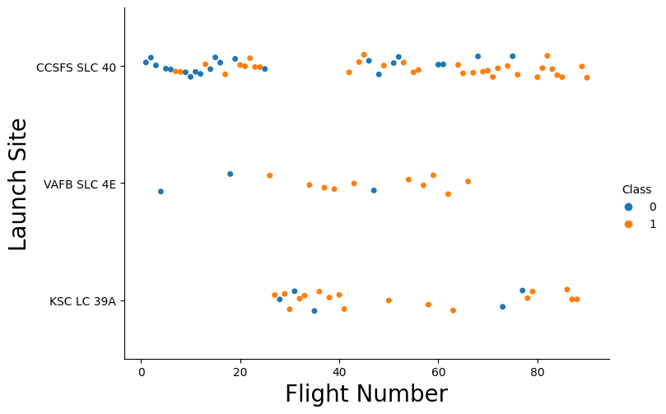
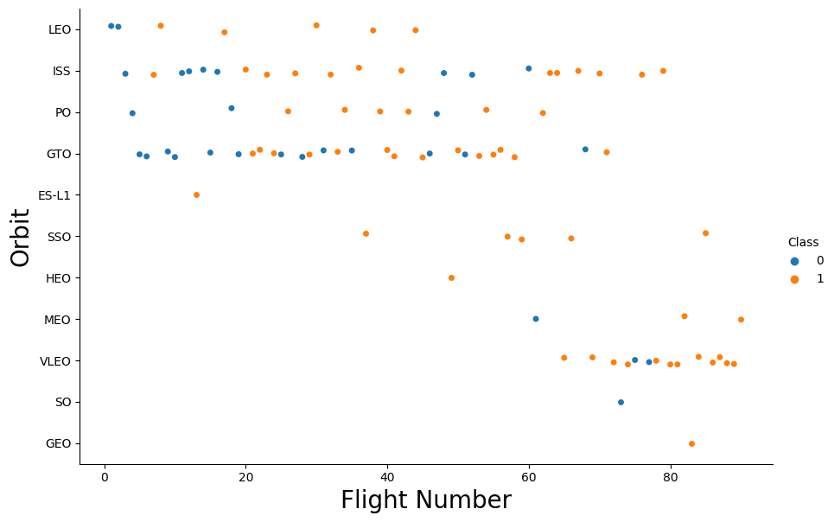
EDA with Data Visualization
Used scatter plots to Visualize the relationship between Flight Number and Launch Site.
Used scatter plots FlightNumber and Orbit type

Slide 12
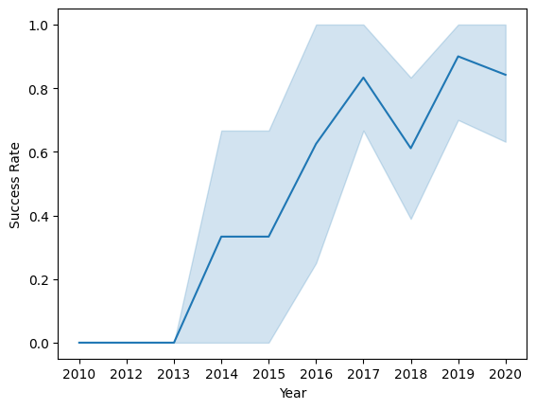
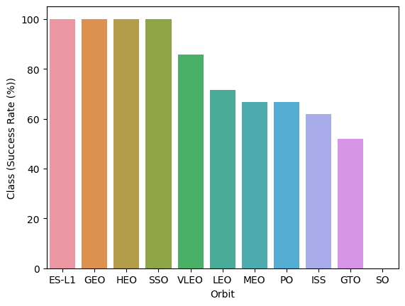
EDA with Data Visualization
Line plot to Visualize the launch success yearly trend.
Used Bar chart to Visualize the relationship between success rate of each orbit type

Slide 13
EDA with SQL
A connection to SQLlite database is created and the SpaceX dataset is then copied in a table in the database
These are samples of SQL queries were performed for EDA
Display the names of the unique launch sites in the space mission
Display 5 records where launch sites begin with the string 'CCA‘
The total number of successful and failure mission outcomes
Here is the complete EDA with SQL GitHub link: SQL_spaceX_link

Slide 14
Build a Dashboard with Plotly Dash
Built an interactive dashboard application with Plotlydash by:
Adding a Launch Site Drop-down Input Component
Adding a callback function to render success-pie-chart based on selected site dropdown
Adding a Range Slider to Select Payload
Adding a callback function to render the success-payload-scatter-chart scatter plot
Here is the GitHub URL of your completed PlotlyDash lab: SpaceX_launch_dashboard_link

Slide 15

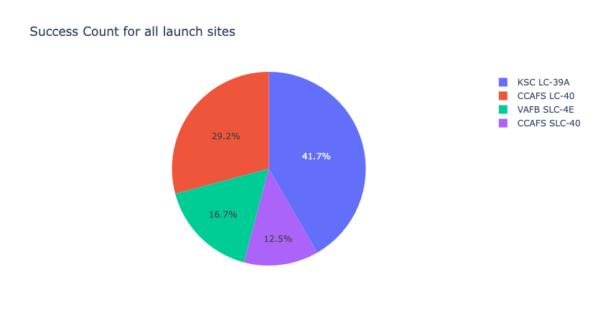
Build a Dashboard with Plotly Dash

Slide 16
Predictive Analysis (Classification)
The goal is to predict if the first stage will land, so we can determine the cost of a launch
Predictive analysis was done using 4 different method: Logistic regression, Support vector machine, Decision Tree, K nearest neighbors
Steps:
Perform exploratory Data Analysis and determine Training Labels
create a column for the class
Standardize the data
Split into training data and test data
Find best Hyperparameter using GridSearch for SVM, Classification Trees and Logistic Regression
Find the method performs best using test data
Here is the project GitHub link: the last section is related Predictive analysis SpaceX-Falcon-9-link

Slide 17
Results
Exploratory data analysis results
Interactive analytics demo in screenshots
Predictive analysis results

Slide 18

Section 2

Slide 19
Flight Number vs. Launch Site
It can be concluded, as the flight number increases in 3 types of launch sites, so does the success rate. For instance, the success rate for the VAFB SLC 4E launch site is 100% after the Flight number 50. Both KSC LC 39A and CCAFS SLC 40 have a 100% success rates after 80th flight.

Slide 20
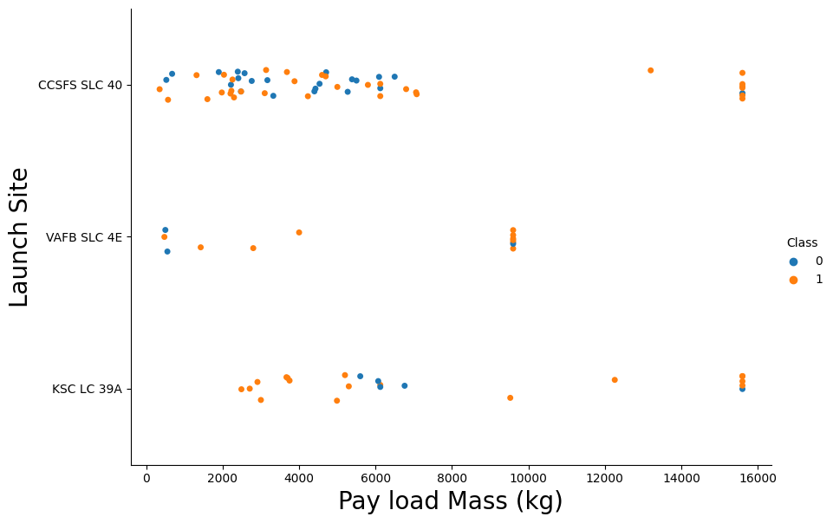
Payload vs. Launch Site
Now if you observe Payload Vs. Launch Site scatter point chart you will find for the VAFB-SLC launchsite there are no rockets launched for heavypayload mass(greater than 10000).

Slide 21
Success Rate vs. Orbit Type
Orbits ES-L1, GEO, HEO & SSO have the highest success rates at 100%, with SO orbit having the lowest success rate at ~50%. Orbit SO has 0% success rate.

Slide 22
Flight Number vs. Orbit Type
You should see that in the LEO orbit the Success appears related to the number of flights; on the other hand, there seems to be no relationship between flight number when in GTO orbit.

Slide 23
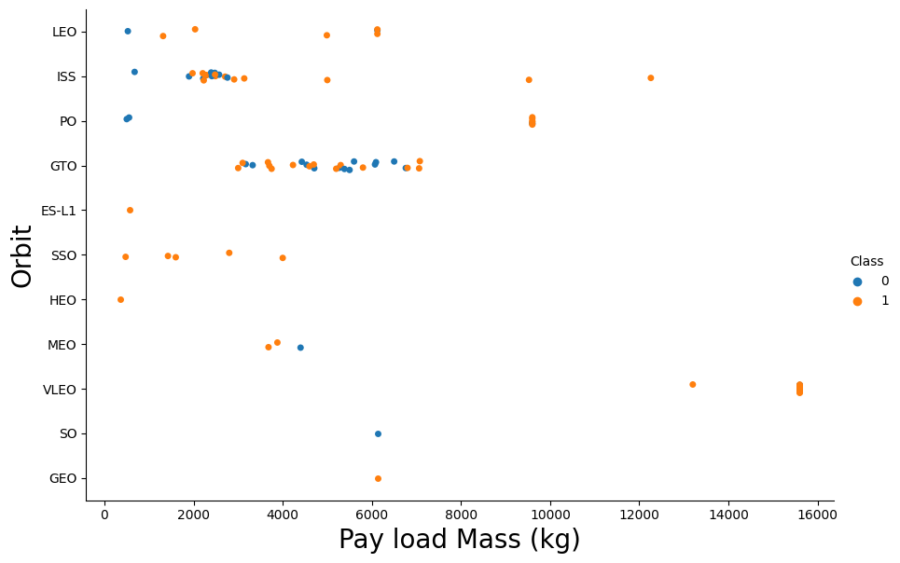
Payload vs. Orbit Type
With heavy payloads the successful landing or positive landing rate are more for Polar, LEO and ISS.
However for GTO we cannot distinguish this well as both positive landing rate and negative landing(unsuccessful mission) are both there here.

Slide 24
Launch Success Yearly Trend
you can observe that the success rate since 2013 kept increasing till 2020

Slide 25
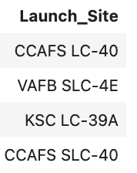
All Launch Site Names
Unique launch sites
%sql SELECT DISTINCT "Launch_Site" FROM SPACEXTABLE;

Slide 26
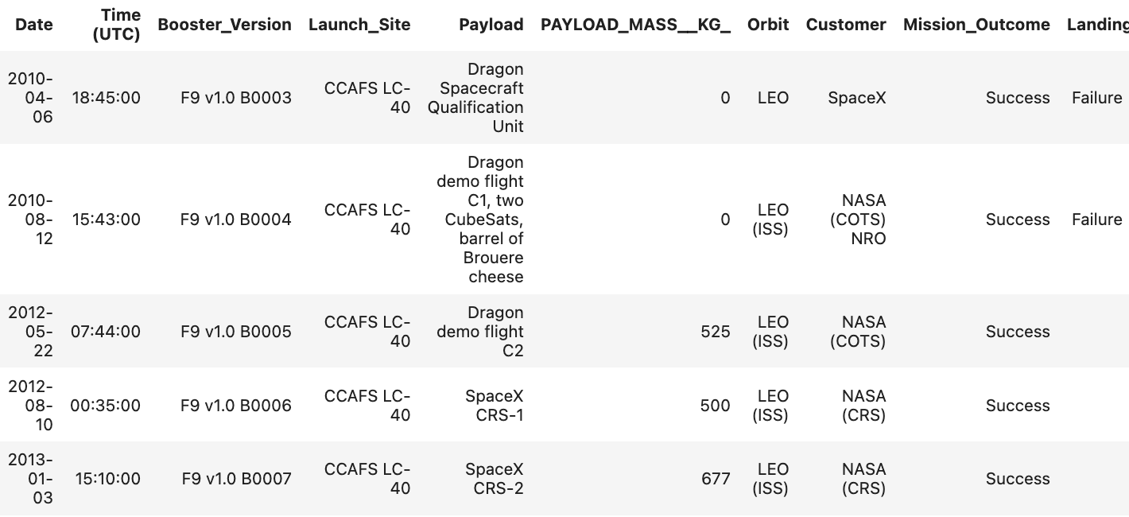
Launch Site Names Begin with 'CCA'
5 records where launch sites begin with `CCA`
%sql SELECT * FROM SPACEXTABLE WHERE "Launch_Site" LIKE 'CCA%' LIMIT 5;

Slide 27
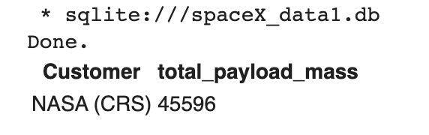
Total Payload Mass
Calculate the total payload carried by boosters from NASA
%sql SELECT "Customer", SUM("PAYLOAD_MASS__KG_") AS total_payload_mass FROM SPACEXTABLE GROUP BY "Customer" HAVING "Customer" = 'NASA (CRS)';

Slide 28
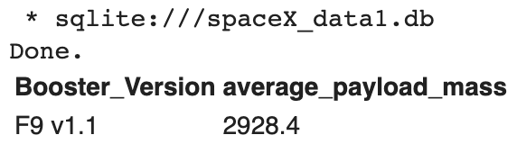
Average Payload Mass by F9 v1.1
The average payload mass carried by booster version F9 v1.1
%sql SELECT "Booster_Version", AVG("PAYLOAD_MASS__KG_") AS average_payload_mass FROM SPACEXTABLE WHERE "Booster_Version" = 'F9 v1.1';

Slide 29
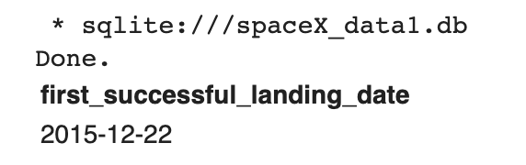
First Successful Ground Landing Date
The dates of the first successful landing outcome on ground pad
%sql SELECT MIN("Date") AS first_successful_landing_date \
FROM SPACEXTABLE WHERE "Landing_Outcome" = 'Success (ground pad)';

Slide 30
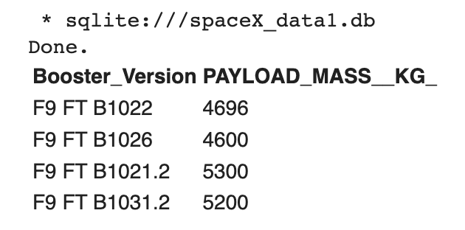
Successful Drone Ship Landing with Payload between 4000 and 6000
The names of boosters which have successfully landed on drone ship and had payload mass greater than 4000 but less than 6000
%sql SELECT "Booster_Version","PAYLOAD_MASS__KG_" FROM \
SPACEXTABLE WHERE "Landing_Outcome" = 'Success (drone ship)' AND "PAYLOAD_MASS__KG_" > 4000 AND "PAYLOAD_MASS__KG_" < 6000;

Slide 31
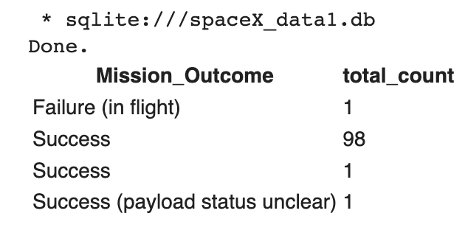
Total Number of Successful and Failure Mission Outcomes
The total number of successful and failure mission outcomes
%sql SELECT "Mission_Outcome", COUNT(*) AS total_count FROM SPACEXTABLE \
GROUP BY "Mission_Outcome";

Slide 32
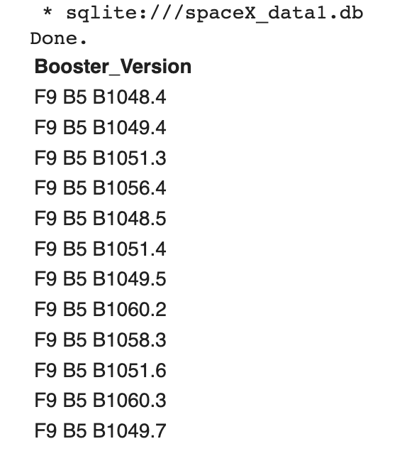
Boosters Carried Maximum Payload
The names of the booster which have carried the maximum payload mass
%sql SELECT "Booster_Version" FROM SPACEXTABLE WHERE \
"PAYLOAD_MASS__KG_" = (SELECT MAX("PAYLOAD_MASS__KG_")FROM SPACEXTABLE);

Slide 33
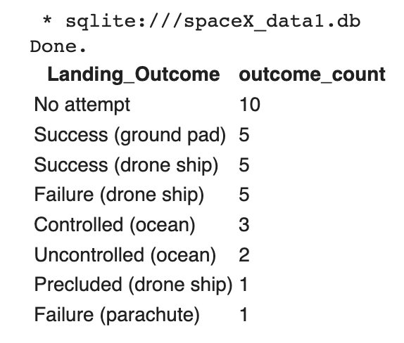
Rank Landing Outcomes Between 2010-06-04 and 2017-03-20
Rank the count of landing outcomes (such as Failure (drone ship) or Success (ground pad)) between the date 2010-06-04 and 2017-03-20, in descending order
%sql SELECT "Landing_Outcome", COUNT(*) AS outcome_count FROM SPACEXTABLE \
WHERE "Date" BETWEEN '2010-06-04' AND '2017-03-20' \
GROUP BY "Landing_Outcome" \
ORDER BY outcome_count DESC;

Slide 34

Section 3

Slide 35
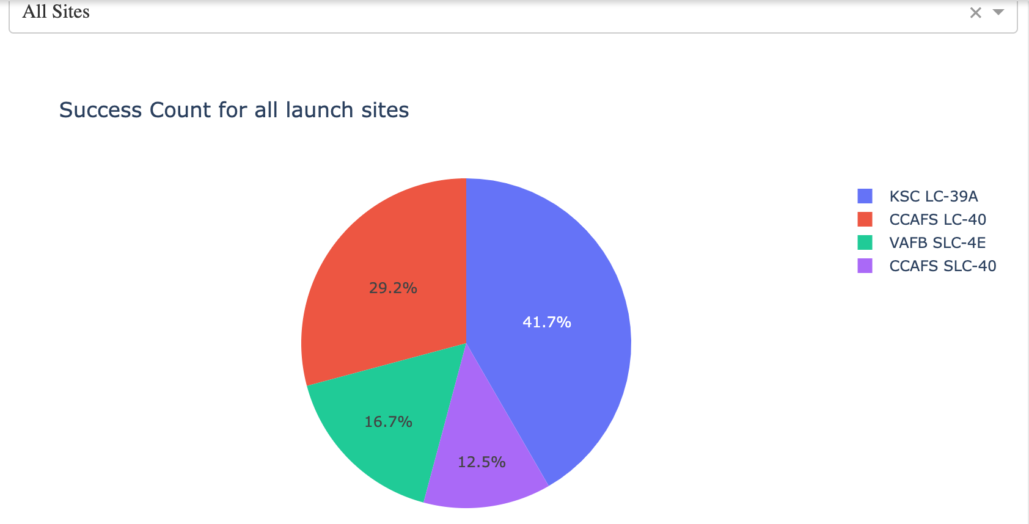
Pie-Chart for launch success count for all sites
Launch site KSC LC-39A has the highest launch success rate at 42% followed by CCAFS LC-40 at 29%, VAFB SLC-4E at 17% and lastly launch site CCAFS SLC-40 with a success rate of 13%

Slide 36
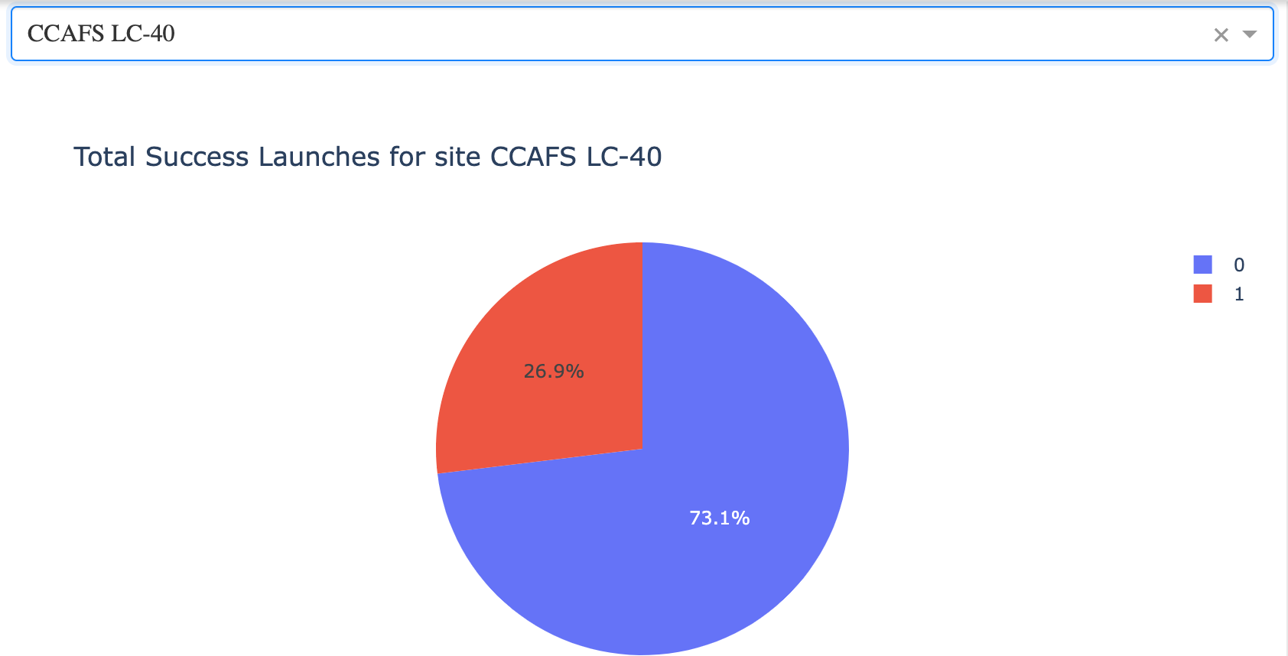
Pie chart for the launch site with 2ndhighest launch success ratio
Launch site CCAFS LC-40 had the 2ndhighest success ratio of 73% success against 27% failed launches

Slide 37
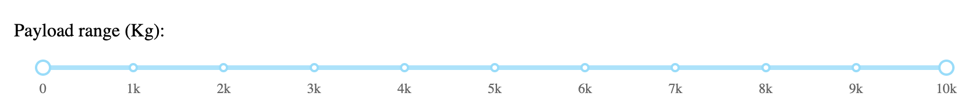
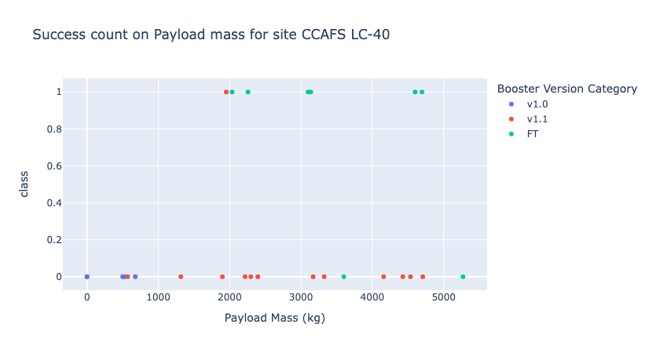
Payload vs. Launch Outcome scatter plot for all sites
For Launch site CCAFS LC-40 the booster version FT has the largest success rate from a payload mass of >2000kg

Slide 38

Section 4

Slide 39
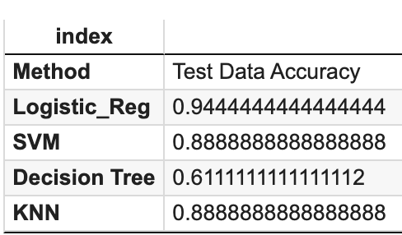
Classification Accuracy
The built models accuracy on test data

Slide 40
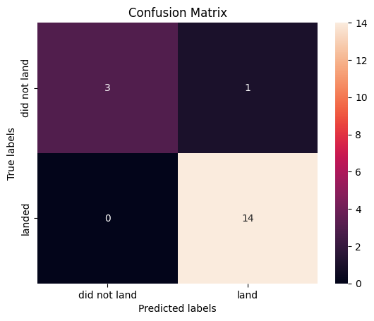
Confusion Matrix
The best performing model was Logistics Regression and this the confusion matrix related to that

Slide 41
Conclusions
Different launch sites have different success rates. CCAFS LC-40, has a success rate of 60 %, while KSC LC-39A and VAFB SLC 4E has a success rate of 77%.
We can deduce that, as the flight number increases in each of the 3 launch sites, so does the success rate. For instance, the success rate for the VAFB SLC 4E launch site is 100% after the Flight number 50. Both KSC LC 39A and CCAFS SLC 40 have a 100% success rates after 80th flight
If you observe Payload Vs. Launch Site scatter point chart you will find for the VAFB-SLC launch site there are no rockets launched for heavy payload mass(greater than 10000).
Orbits ES-L1, GEO, HEO & SSO have the highest success rates at 100%, with SO orbit having the lowest success rate at ~50%. Orbit SO has 0% success rate.
LEO orbit the Success appears related to the number of flights; on the other hand, there seems to be no relationship between flight number when in GTO orbit
With heavy payloads the successful landing or positive landing rate are more for Polar, LEO and ISS. However for GTO we cannot distinguish this well as both positive landing rate and negative landing(unsuccessful mission) are both there here
Finally the success rate since 2013 kept increasing till 2020.

Slide 42


